Slide 1
Welcome!

Slide 2
Announcements
Homecoming 5K
Homecoming Game Tailgate
Ice cream Social with APSA (Asian Pacific Student Alliance)
Nov 16 (Monday)
5:30 PM
Movie Night with ACHA (Association of Chicana Activists)
Nov 18 (Wednesday)
4 PM
Facebook Group
https://www.facebook.com/groups/1516838651966799/

Slide 3
International Student Volunteers

Slide 4
Informational meetings
Nov 5 (Thursday)
AH3113
4 - 7 PM
Nov 6 (Friday)
Physics 146
9 - 12 PM

Slide 5
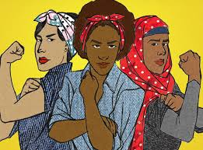
what is intersectional feminism?

Slide 7
privilege vs systematic advantage
privilege: suggests it is something to be desired
systematic advantage: describes how the over all system is designed so that some people are benefiting from it while others are being oppressed.

Slide 8
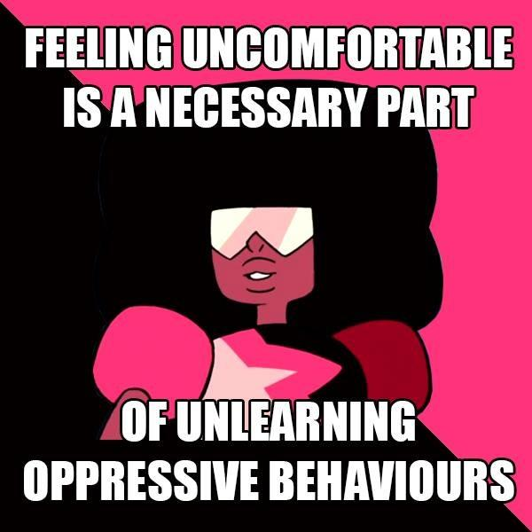

Slide 9
https://youtu.be/yTvakFCs8No

Slide 10
What are some systematic advantages you experience?

Slide 11
what are some systematic disadvantages you face?

Slide 12
feminism: the advocacy of women’s rights on the grounds of social, political, and economic equality to men

Slide 13
What is intersectionality?
The view that women experience oppression in varying configurations and in varying degrees of intensity. Cultural patterns of oppression are not only interrelated, but are bound together and influenced by the intersectional systems of society. Examples of this include race, gender, class, ability, and ethnicity

Slide 14
7 things you should know about feminism
Feminism = Gender Equality
Feminists don’t hate men
Feminist don’t think women are better than men
The term feminism isn’t just for women
There are many types of feminism
When you say you’re not a feminist, we hear you think women are second class citizens
Saying you're not a feminist doesn’t mean you’re not actually practicing feminisms

Slide 15
tool for analysis, advocacy and policy development
how gender can intersect with other identities
how do they contribute to oppression and privilege

Slide 16
https://www.youtube.com/watch?v=z-nmxnmt_XU

Slide 17
think of a situation in which a person’s intersection of identities may leave leave at a disadvantage?

Slide 18
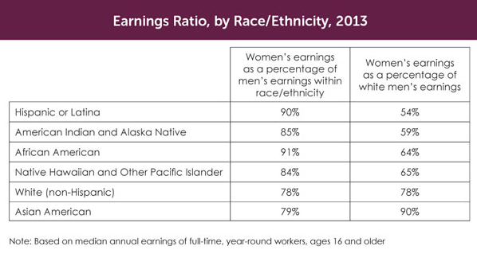
the race effect

Slide 19
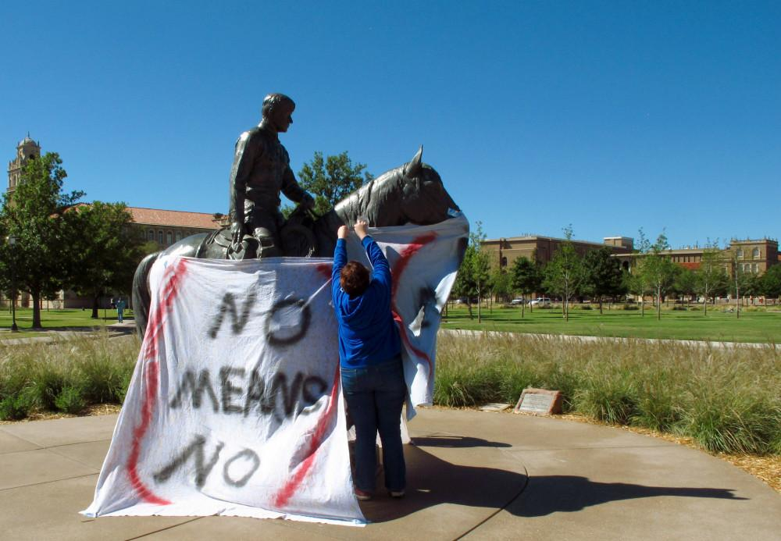
Rape Culture
Researchers asked 86 college men if they would “rape a woman” if no one would know and there would be no consequences and 13.6% said yes. When asked if they would “force a woman to sexual intercourse,” that percentage more than doubled: 31.7% said yes.

Slide 20
rape culture: is a setting in which rape is pervasive and normalized due to societal attitudes towards gender and sexuality

Slide 21
can you think of example that perpetuate rape culture

Slide 22
what can you do to stop rape culture?

Slide 24
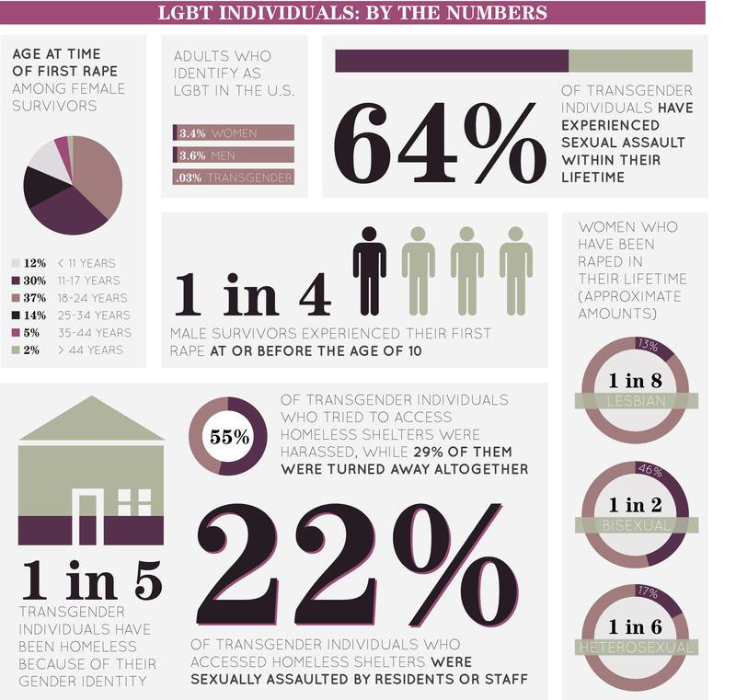

Slide 25
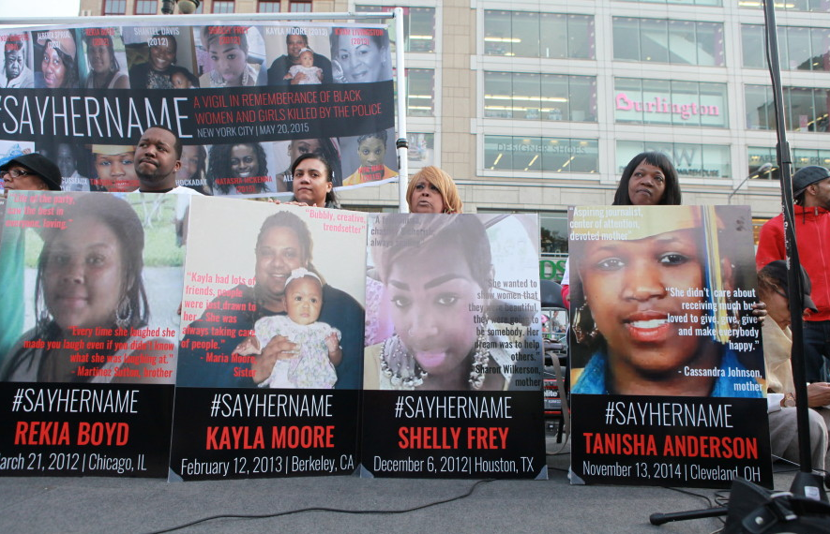
#SAYHERNAME
while black men accounted for 55.7 percent of police stops for men, black women accounted for 53.4 percent of all women stopped . Overpoliced AND uNDERPROTECTED.

Slide 26
Hyper-masculinity and toxic masculinity

Slide 27
We teach boys to be afraid of fear, of weakness, of vulnerability. We teach them to mask their true selves, because they have to be, in Nigerian-speak—a hard man.

Slide 28
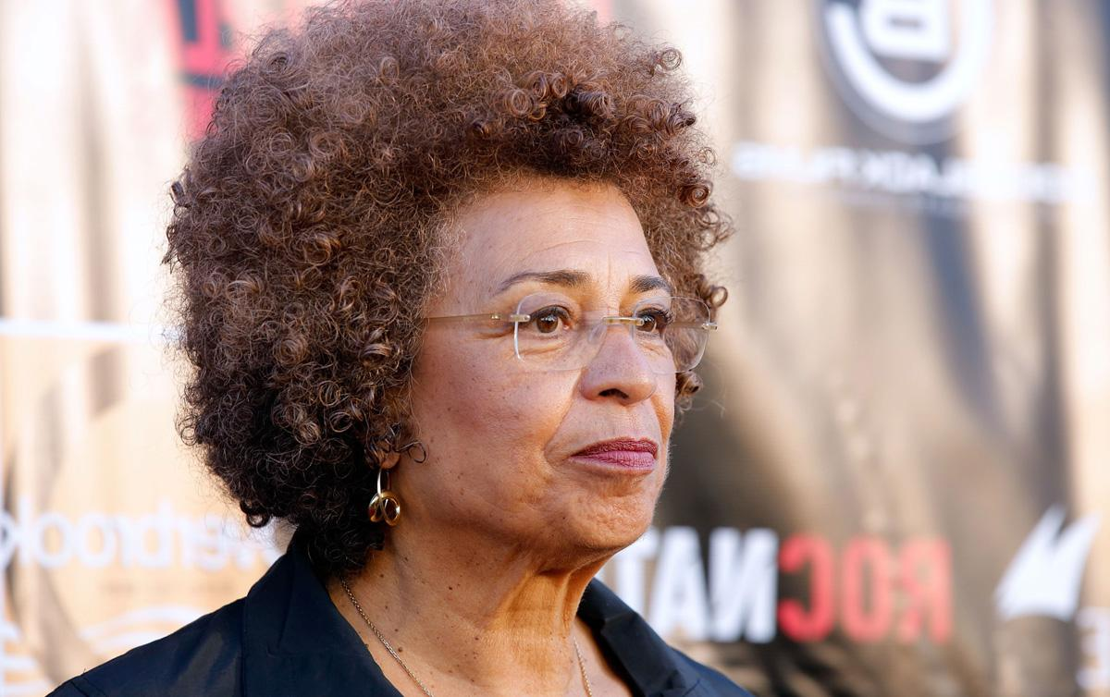
“Feminist approaches urge us to develop understandings of social relations, whose connections are often initially only intuited. (108)”

Slide 29
take home message:
gender should not be a default reason as to why you should or should not do or be something

Slide 30
FREE FOOD!
Interested in becoming a Psychologist?
Want to learn about bi-racial identity?
How can we use multiculturalism?

