Slide 1
Welcome friends!

Slide 2
Happy International Women’s Day!

Slide 3
Community Representative for Spring 2016!
March 8 (Tuesday) at 5:30 PM
Center for Intercultural Relations
Email us if interested: cscc.sdsu@gmail.com

Slide 4
Volunteers Needed!
March 19, 2016 (Saturday)
Between 9 AM to 2 PM
Earn Points! 1 point per hour (max of 2 points can be earned)
Sign up: https://docs.google.com/spreadsheets/d/1XFv2cuEer8jNGaEPdG0UzeZF-Lg38QeaynyVZLe4_wo/edit?usp=sharing

Slide 5
Upcoming Events
March 19 (6 - 8 PM)
Mt. Soledad Presbyterian Church
https://www.eventbrite.com/e/2016-evening-of-hope-presents-supporting-the-struggle-tickets-19680144843
April 30
Check in at 7:30 AM, Starts at 9:30 AM
Liberty Station
Make sure to join team “Counseling & Social Change Club” when registering
http://www.namiwalks.org/index.cfm?fuseaction=donorDrive.event&eventID=538

Slide 6
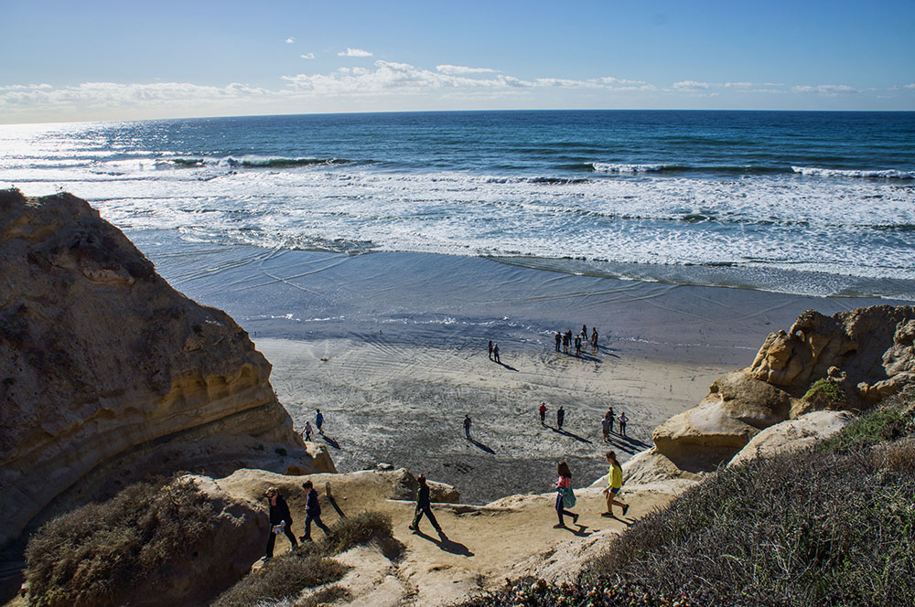
More Events...
Hiking Social
March 18 (Friday) at 11:00 AM
Torrey Pines Beach Trail
Earn 1 Point
Carpool at Zura
https://www.facebook.com/events/1672773312974075/
Yogurtland Fundraiser
Make sure to mention Counseling & Social Change Club when purchasing
March 15 (Tuesday)
ALL DAY!
Earn 1 point
Hangout with the E-board from 4:30-6:00 PM

