Slide 1
Welcome Back Change Agents!
Follow us on Instagram: @cscc_sdsu
… and like us on Facebook: www.facebook.com/sdsucscc/
… and check out our website:
csccsdsu.weebly.com
… and this is our email:
cscc.sdsu@gmail.com

Slide 2
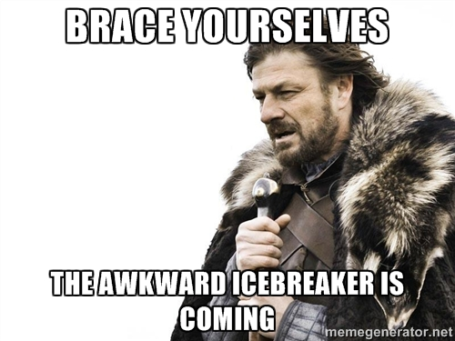
Ice Breaker Time...

Slide 3
Join us as we host our
2nd Annual Post-Modern Social Justice Symposium !!!!
WHEN: April 14th (12 - 6pm)
WHERE: Student Union Theatre
*Be sure to register ASAP as space is limited!

Slide 4
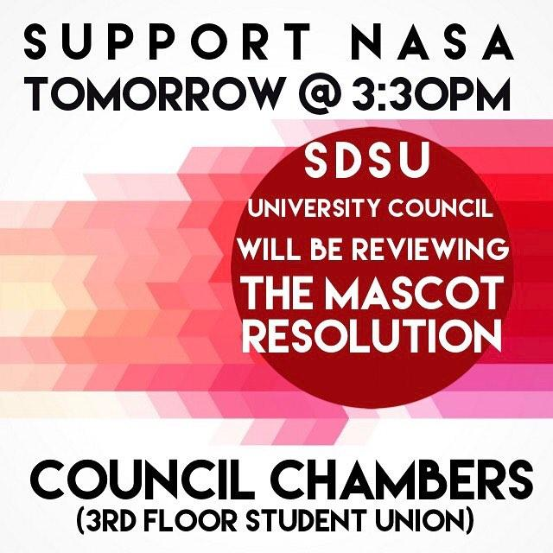
Upcoming Events:
1. Wednesday, March 22nd
(3:30pm - 6:30pm):
University Vote on SDSU Mascot
2. March 20-23rd (24/7):
Mock Israeli Apartheid Wall

Slide 5
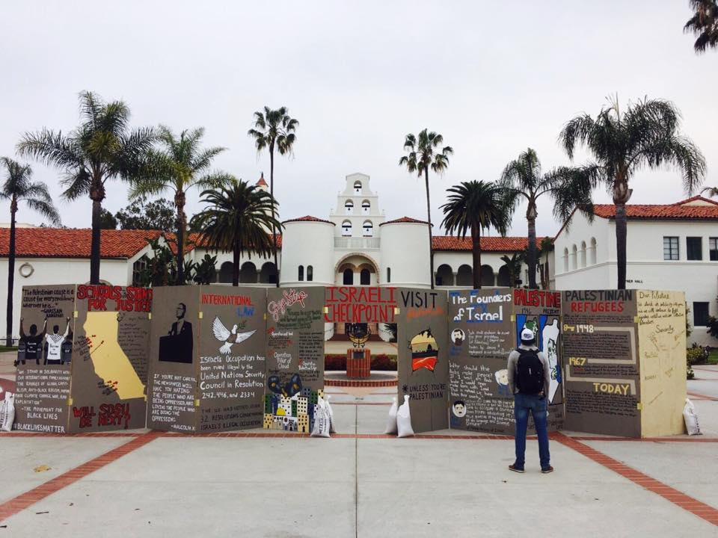
Source: SDSU Students for Justice in Palestine Facebook

Slide 6
Upcoming Events:
3. April 3rd-7th:
Public Health Week
4. Thursday, April 6th (7-9pm):
New Officer Elections!!!

Slide 7
WHAT: NAMI Walk of San Diego County
WHEN: Saturday, April 29th
WHERE: NTC Park
Register at www.NAMIWalks.org/SanDiegoCounty
When registering be sure to select the Counseling and Social Change Club Team!

Slide 8
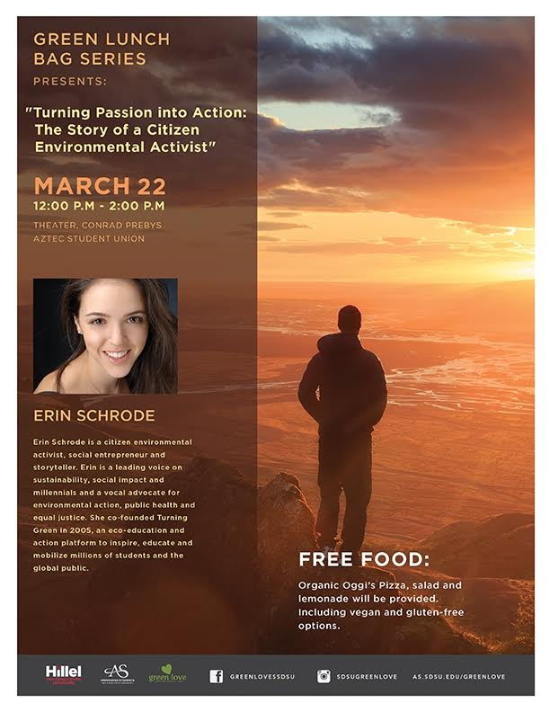
Turning Passion into Action: The Story of a Citizen Environmental Activist
Erin Schrode is a citizen environmental activist, social entrepreneur and storyteller. Erin is a leading voice on sustainability, social impact and millennials and a vocal advocate for environmental action, public health and equal justice. She co-founded Turning Green in 2005, an eco-education and action platform to inspire, educate and mobilize millions of students and the global public.
Tomorrow! (3/22) 12:00-2:00 at the Theater, Aztec Student Union

Slide 9
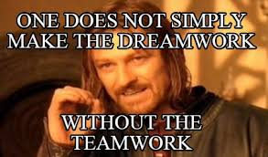
CSCC Officer Panel

Slide 10
Requirements of all Officers
Minimum 2 hour commitment during the school week (3 hours bi-weekly for COESC Representatives)
General body meeting: 1 hour
Officer meeting: 1 hour
*COESC Reps: 1 hour every other week
Attain active status both semesters as an officer
Be accountable for upholding the standards of the club

Slide 11
CSCC President
Preside over all Executive Board and regular membership meetings.
Call all special meetings.
Sign all financial documents of the organization (mandatory).
Represent the Counseling and Social Change Club to the student body and community.
Make sure the executive board is doing their duties and are having clear communication
Skills needed:
Leadership, assertion, patience, compassion, communication

Slide 12
CSCC Vice President
Act as the President should the President for any reason be unable to carry out the Presidential duties
Assist the President in administering the business of the executive board
Works closely with president to create/organize events
Be accountable for upholding the standards of the club
Skills needed:
Clear communication
Time management
Leadership & Organization

Slide 13
CSCC Treasurer
Balance the AS Bank Account
Process payments and reimbursements
Make deposits and withdrawals
Go to AS Banking trainings
Manage the yearly budget from College of Education
Organize fundraising events
Collect dues from members and deposit them to our bank account in a timely manner

Slide 14
Skills needed:
Organizational Skills - need to be able to keep your own transaction records and be ready to share accurate financial information at executive meetings
Time management - need to be able to walk to the AS office to make deposits, withdrawals and request checks
Communication Skills- need to be able to maintain a good relationship with AS banking, fundraising connections, vendors, the College of Education and other organizations we do financial business with

Slide 15
CSCC Secretary
Keep track of membership points/attendance at socials, community service, general meetings, etc.
Create powerpoints for general meetings
Create weekly emails with announcements
Skills needed:
Computer skills (ie. typing, excel, powerpoint)
Google drive
Emails
Organization

Slide 16
CSCC Campus Representative
Attend College of Education council meetings (bi-weekly)
Really important! We lose money for every meeting missed.
Outreach to other organizations on campus
PLSC
Coordinate campus outreach (promote our organization to help its growth)
Create events to raise awareness on counseling, cultural competence or social justice issues/concerns
Provide training opportunities for club ambassadors (ex: QPR trainings, cpr/first aid, mental aid first health etc…)
Be accountable for upholding the standards of the club
Skills needed: punctuality, reliability, organizational skills, teamwork, and relational skills.

Slide 17
CSCC Community Representative
Section 5. The duties of the Community Relations Representative shall be:
Look for involvement opportunities in the community
Outreach to organizations off campus
Look for community service opportunities/Resources (ex: school events, community events etc.)
Internship opportunities
Community health center tours, offices and more.
Be accountable for upholding the standards of the club
Skills needed: Patience, Flexibility, Planning, Research, Creativity,

Slide 18
CSCC Historian
In charge of social media/ other media relations (Instagram, facebook, club website)
Advertising events and upcoming meetings on social media
Editing website and inputting meeting minute powerpoints
Take photographs at events, fundraisers, meetings
Create end of year banquet slideshow
Be accountable for upholding the standards of the club
Skills needed: Creativity, website editing, organization

Slide 19
New Officer Elections are on April 6th from 7:00 pm - 9:00 pm (location TDB)

Slide 20
Questions? :D
Don’t forget to fill out the interest form for an officer position found at the bottom of our newsletter!

