Slide 1
Welcome Back Change Agents!
Follow us on Instagram: @cscc_sdsu
… and like us on Facebook: www.facebook.com/sdsucscc/
… and check out our website:
csccsdsu.weebly.com
… and this is our email:
cscc.sdsu@gmail.com

Slide 2
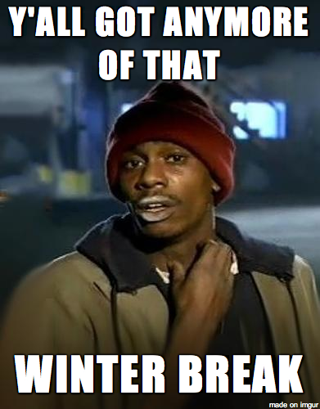
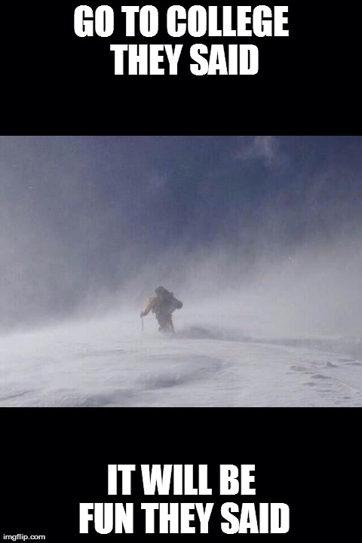
Ice Breaker Time...

Slide 3
Upcoming Events:
Friday, February 24th (10-12pm):
Feeding America Volunteer Event
Wednesday, March 8th (7-9:30pm):
Rape Culture & Reproductive Justice
Monday, March 13th (5-7pm) OR
Monday, March 20th (5-7pm):
FREE Trauma Informed Care Workshop

