Slide 1
Welcome Change Agents!
Follow us on Instagram: @cscc_sdsu
… and like us on Facebook: www.facebook.com/sdsucscc/
… and check out our website:
csccsdsu.weebly.com
… and this is our email:
cscc.sdsu@gmail.com

Slide 2
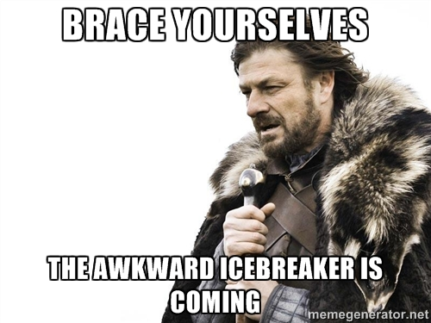
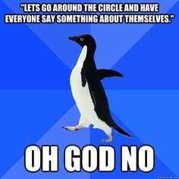
Ice Breaker Time...

Slide 3
Upcoming Events:
Nov. 28th - Dec. 2nd : EOP Student Advisory Board Toy Drive in Student Life and Leadership Center & Aztec Mesa 108 (1 point for donation)
Dec. 2nd: EOP Student Advisory Board Winter Wonderland Event for Student Parents - Aztec Mesa, 4-7pm (1 point for attendance)
December 6th - Member Appreciation Day!

Slide 4
Next Week!
Member Appreciation Day!
We want to thank every one of you for being a part of our club this semester and contributing to all it has become! Join us at our last meeting of the semester for a relaxed get together to celebrate yourselves!

Slide 5
SDSU Grad School Panel!

Slide 6
See you next Tuesday!

