Slide 1
Welcome Change Agents!
Follow us on Instagram: @cscc_sdsu
… and like us on Facebook: www.facebook.com/sdsucscc/
… and check out our website:
csccsdsu.weebly.com
cscc.sdsu@gmail.com

Slide 2
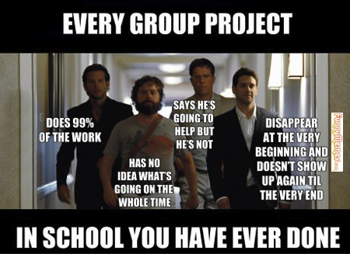
Ice Breaker Time...

Slide 3
Hey Victoria, how do I become an Active Member?
By being an E-Board Member
… or by gaining 12 points each semester in 2 consecutive semesters + paying $35 in membership fees (t-shirt & banquet included)
Graduating Active Members receive a purple cord at the end of the year banquet
Returning Active Members who do not want a new T-shirt can pay $30 in fees instead
STILL ACCEPTING MEMBERSHIP FEES!

Slide 4
Upcoming Events:
Oct. 22: San Diego Youth Services Volunteer Orientation/Training, 10am-12pm
Oct. 22: SDSU Master’s in School Counseling Program, Future School Counseling Day @ NE 60, 10-12pm
Nov. 7 - Marriage and Family Therapy Program Info Session @ EBA 339, 10am-11:30am

Slide 5
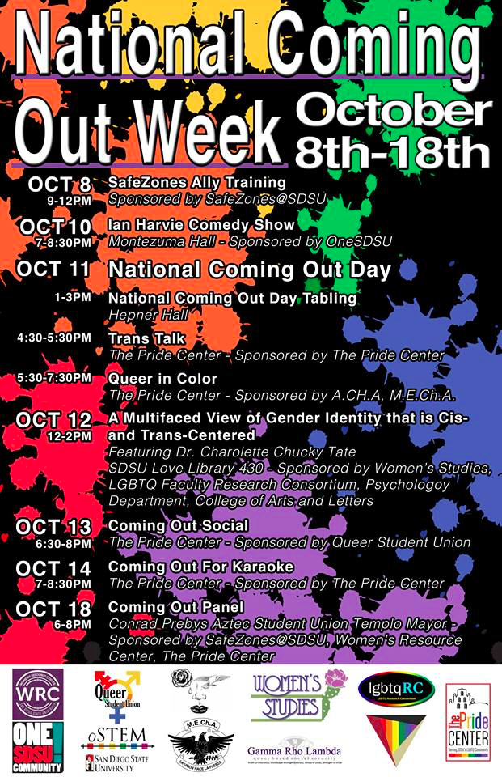
National Coming Out Week is Oct. 8th-18th

Slide 6
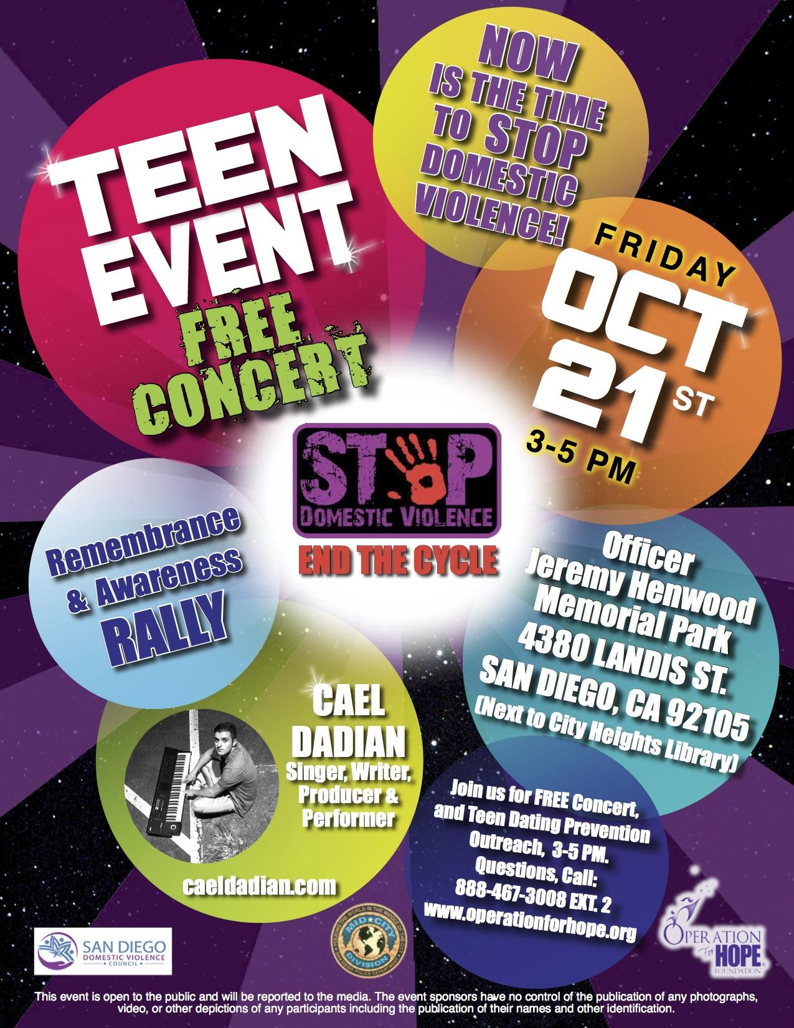
San Diego Domestic Violence Council Presents…

Slide 7
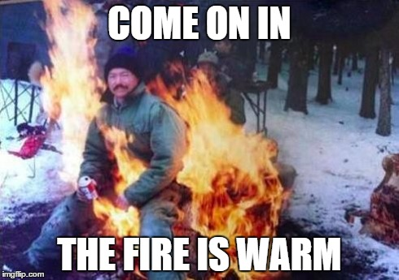
It’s our Annual Bonfire Social!
Let’s have a bonfire on Saturday Oct. 15th at Mission Beach from 7pm-9pm! We’ll get together to relax by the nice fire!

Slide 8
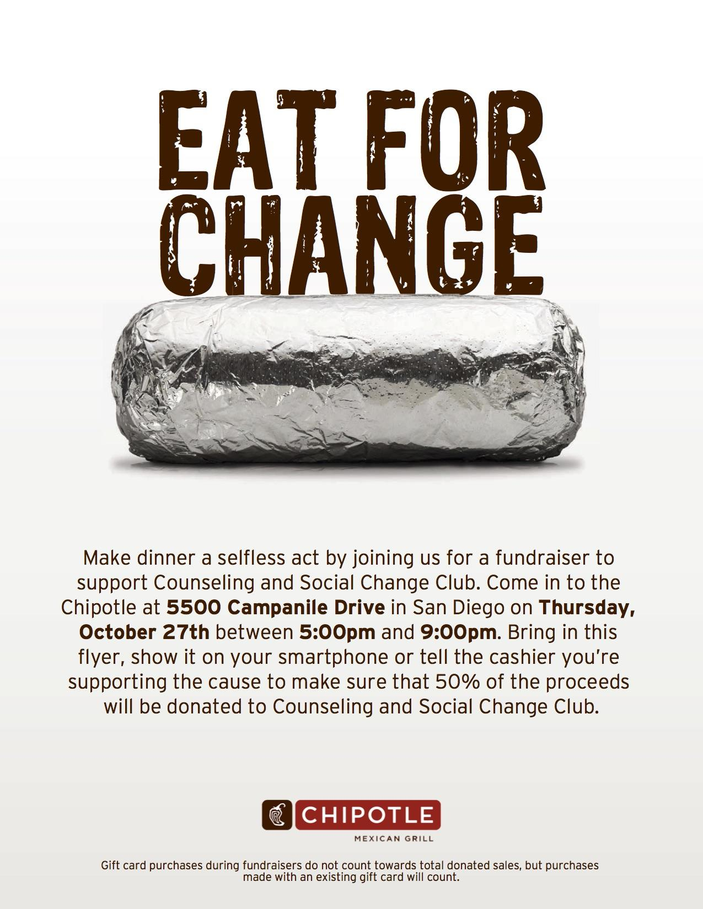
It’s Fundraising Time!
Join us at the SDSU Chipotle (first floor of Student Union) on Thurs Oct. 27 from 5-9pm! 50% of the proceeds go to CSCC! Please present this flyer or mention CSCC to contribute!

Slide 9
2nd Annual Mental Health First Aid Training

Slide 10
Mid City Can presents: Youth Power Summit on Saturday, Oct. 22nd from 8am-3:30pm
RSVP @ MIDCITYCAN.ORG/YOUTHPOWER

Slide 11
The Leadership Certificate program is open to any SDSU student at any class level.
In the Leadership Certificate program, you will select from an array of leadership experiences: seminars, off-campus retreats, conferences, peer educator training workshops, service projects, student clubs and organizations, living-learning communities, and unique campus initiatives, all thoughtfully designed to help you foster your leadership development.

Slide 12
Leadership Learning
Five (5) Required Workshops
Introduction to Leadership Theory
Leadership Values
True Colors
Conflict Styles
Attend a ONE SDSU Community event AND a Campus Collegiate Dialogue Session (Must attend both to receive credit)*

Slide 13
Leadership Learning cont.
Two (2) Self-Selected Workshops
Etiquette Uploaded
Time Management
The Relational Leader
Strengths Finder
A workshop in the Leadership Lunch Series
Student Organization Conflict and Identity Awareness Training (Must attend both Session A and Session B to receive credit; counted as one workshop)
Other on-campus leadership related workshop

Slide 14
2. Experiential Leadership
Participate in two (2) of the following:
Aztec CORE Leadership Retreat or Greek Life Team Retreat
SDSU Leadership Summit Conference
Freshman Leadership Connection (freshman only, fall semester)
Volunteer as a tutor for the Casa Azteca/Aztec Freshman Connection commuter program for 20 hours (one semester)
Participate in the MLK Jr. Day Parade as a volunteer for the University Planning Committee
Participate in the San Diego LGBT Pride Parade as a volunteer with the University Planning Committee
Other experiential program (Must be approved in advance by the Leadership Certificate Advisor)

Slide 15
3. Leadership Service
Participate in ten (10) hours of community service and report online at http://studentaffairs.sdsu.edu/SLL/leadership/serviceopportunities.html
Service:
Number of hours: ____ Date completed: __________
List of pre-approved organizations at https://go.sdsu.edu/student_affairs/sll/leadership-service-opportunities.aspx
Qualifications of community service at https://go.sdsu.edu/student_affairs/sll/files/05142-Qualifications_of_Community_Service.pdf
Will come back to this topic

Slide 16
4. Leadership Role
Participate in a current leadership role on campus for a minimum of twenty (20) hours with major responsibilities
Prior: Submit a detailed description of the position and personal goal statement of what you hope to achieve in this role to the Leadership Certificate Advisor
Submit 3 goals prior to role to Leadership Certificate Advisor
After completion of the leadership role: Turn in a Letter of Verification from the organization/group faculty/staff advisor to the Leadership Certificate Advisor.

Slide 17
5. Leadership and Mentoring
Participate in the SDSU Career Services Aztec Mentor Program Complete eight to twelve (8-12) hours of commitment Semester completed:
OR
Participate in a pre-approved internship with Student Life & Leadership for one semester: This internship must be pre-approved by the Director or Associate Director of Student Life & Leadership

Slide 18
6. Critical Thinking and Reflection Capstone
After completing all the specified requirements of the certificate above, you will be asked produce a “Capstone Reflection Paper/Video.”
Set up an advising appointment with Chelsea Winer, Assistant Student Life Advisor, at cwiner@mail.sdsu.edu for further information.

Slide 19
Community Service Certificate
A community service certificate will be awarded for every 100 hours you log with Student Life & Leadership.
To see if you earned the Community Service Certificate, contact Chelsea Winer (cwiner@mail.sdsu.edu).
Some pre-approved organizations:
American Cancer Society
Cystic Fibrosis Foundation
Embrace
Habitat for Humanity
JDRF San Diego
National Eating Disorder Association (NEDA)
Prevent Child Abuse America
Relay for Life
San Diego Food Bank
San Diego River Park Foundation
Urban Angels

Slide 20
Community Service Certificate cont.
“Community Service” is... Active unpaid participation in the community, and usually involves working with others and facing real life problems and issues head-on. It helps you make a connection between yourself, the skills you have to offer and the needs of the community. Community service focuses on creating positive change in the community where both the server and served learn from their interaction.
Examples: Painting a youth center, serving food at a shelter, or providing dental care to the homeless
Organizations not listed in Student Life and Leadership website can be approved by the Leadership Certificate Advisor.

Slide 21
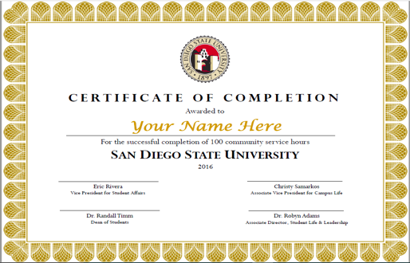

Slide 22
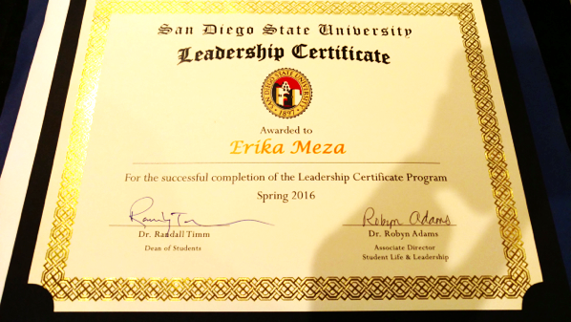

Slide 23
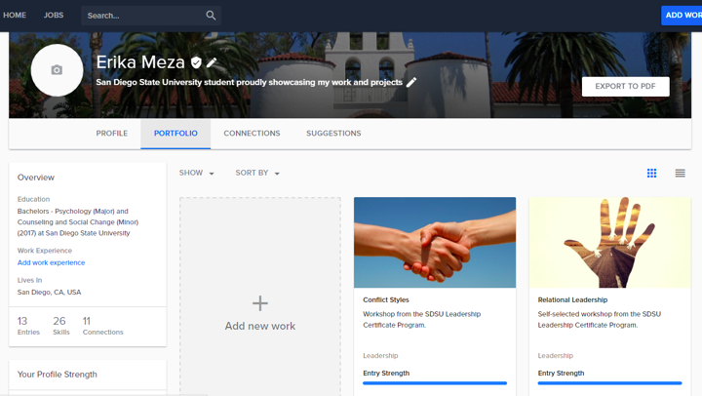

Slide 24
Tips for Success
Create SDSU Portfolium early on the program
Write 1-2 page reflections shortly after the completion of category
Use the SDSU Leadership Certificate Check-list along the way. Found at:
http://go.sdsu.edu/student_affairs/sll/files/05175-Leadership_Certificate_Check-list.pdf
Keep pictures of all workshops and events
Log community service hours shortly after completion of service and keep your own records
Upload entries to SDSU Portfolium as you complete requirements
Check-in with the Director or Associate Director of Student Life & Leadership whenever you have a question about a requirement
Give yourself plenty of time to write the Capstone paper or make the Capstone video

Slide 25
Feedback from SDSU Leadership Certificate participants
As a result of the Leadership Certificate program:
100% of certificate recipients from Spring 2015 reported that their understanding of their leadership style improved.
100% of certificate recipients from Spring 2015 reported that they were satisfied with the Leadership Certificate program.
100% of certificate recipients from Spring 2015 reported that the Leadership Certificate program was worth the time they invested in it.
94% of certificate recipients from Spring 2015 reported that their ability to mediate conflict improved.

Slide 26
Questions?

Slide 27
See you next Tuesday!

